Slide 1

JS Frameworks
Aris Markogiannakis
City University - Short Courses
CS3606 : JavaScript 2: Advanced Javascript for Websites and Web

Slide 2
This week?
This week we will learn about:
Frameworks
ReactJS
Notes:
https://medium.freecodecamp.org/javascript-from-callbacks-to-async-await-1cc090ddad99

Slide 3
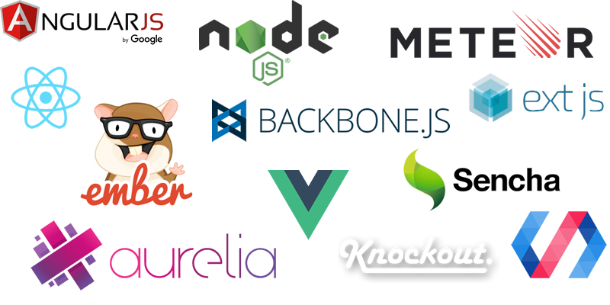
JS Frameworks

Slide 4
Why do we use Frameworks?
Are just tools
Efficiency
Easy to understand, very good for people that start JavaScript development

Slide 5
Setting up our project
Let’s create together a project for our React Project
Step 1:
Create a folder called myfirstreactapp
Step 2:
Open the folder you created with Visual Studio Code:
Step 3:
Using the View menu choose the Integrated Terminal
type npm init

Slide 6
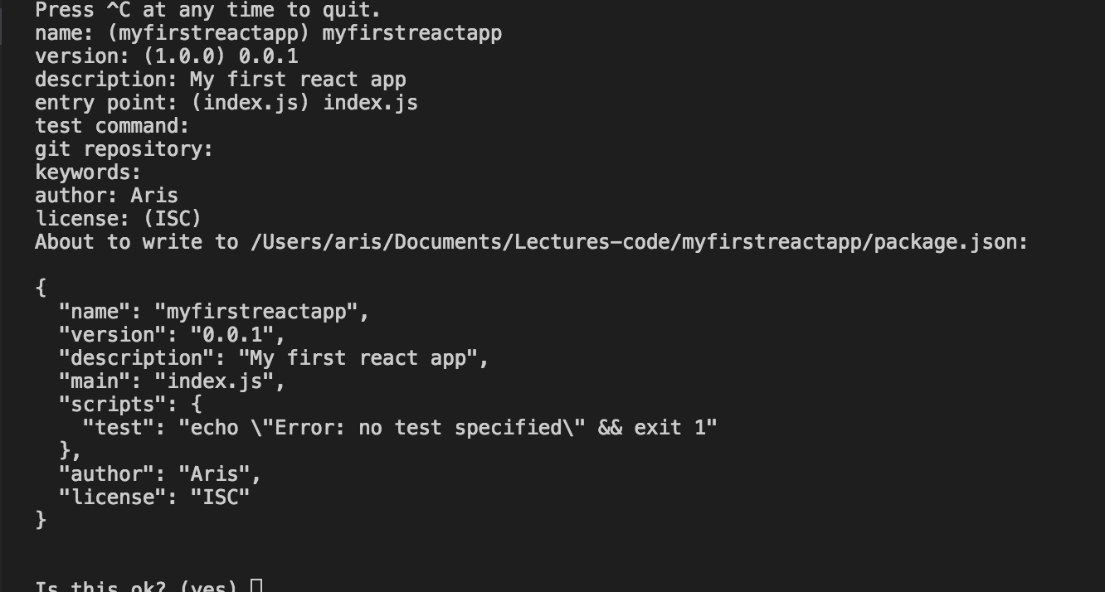
Setting up our project
We create our package json adding some basic information.

Slide 7
Installing Webpack
Webpack is a module bundler which takes modules with dependencies and generates static assets by bundling them together based on some configuration.
The support of loaders in Webpack makes it a perfect fit for using it along with React and we will discuss it later in this post with more details.
Step 4:
On the same folder and inside the integrated terminal type the following:
npm install webpack webpack-cli
-S
-S: means it will save it to the dependancies
-install : install you can also type install

Slide 8
Configuring Webpack
Webpack requires some configuration settings to carry out its work and the best practice is doing it via a config file called webpack.config.js.
Step 5:
On the same folder and inside the integrated terminal type the following:
touch webpack.config.js
If the command doesnt work create a file by urself.

Slide 9
Configuring Webpack
Webpack requires some configuration settings to carry out its work and the best practice is doing it via a config file called webpack.config.js.
Let’s note the following:
APP_DIR - The directory where our code lives
BUILD_DIR - The directory where our final product lives. When we deploy our code we will send what has been created inside the BUILD_DIR. Once we start using the WEBPACK you will notice a bundle.js this is a minified file that is holding all our application files and functionality.
Step 6:
const path = require('path');
module.exports = {
entry: { main: './src/client/app/index.jsx' },
output: {
path: path.resolve(__dirname, 'dist'),
filename: 'app.bundle.js'
},
module: {
rules: [
{
test: /\.scss$/,
use: [
'style-loader',
'css-loader',
'sass-loader'
]
},
{
test: /\.jsx$/,
exclude: /node_modules/,
use: {
loader: "babel-loader"
}
}
]
}
};

Slide 10
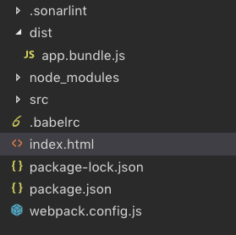
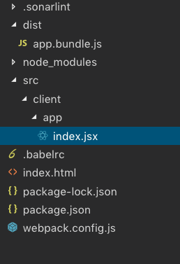
Creating our App
Our application code lives inside the app folder.
Step 7:
Inside our project we need to create the following structure

Slide 11
Setting up Babel
Who remembers what is Babel?
A clue - a transpiler?
Why do we need it?
On this project we will be using JSX and ES6 we can be more productive while working with React. But the JSX syntax and ES6, are not supported in all the browsers.
Step 8:
npm i @babel/core babel-loader @babel/preset-env @babel/preset-react --save-dev

Slide 12
Setup babel
We need to setup babel to let it know how to transpile our code from ES6 to ES5.
Step 8:
On terminal we need to write the following command
touch .babelrc
And then on the babelrc file make sure we have the following
{
"presets": ["@babel/preset-env", "@babel/preset-react"]
}

Slide 13
Create our main html file
We need to create our main html file
Step
Copy the following code to your html file
<html>
<head>
<meta charset="utf-8">
<title>React.js using NPM, Babel6 and Webpack</title>
</head>
<body>
<div id="app"><div>
<script src="dist/app.bundle.js" type="text/javascript"></script>
</body>
</html>

Slide 14
Loaders
We’ve already been introduced to babel-loader, one of many loaders that you can configure to tell webpack what to do when it encounters imports for different file types.
You can chain loaders together into a series of transforms, a good way to see how this works is by importing Sass from our JavaScript.
// webpack.config.js rules: [{ test: /\.scss$/, use: [ 'style-loader', 'css-loader', 'sass-loader' ] }, { // ... }]

Slide 15
React
We have done our application setup it is time now to install react.
Step 9:
Using your terminal type the following:
npm i react react-dom -S

Slide 16
Writing your first code in react
So now let’s write our hello world in react
Step 10:
Inside your index.jsx add the following code:
import React from 'react'; import {render} from 'react-dom'; class App extends React.Component { render () { return <p> Hello React!</p>; } } render(<App/>, document.getElementById('app'));

Slide 17
Let’s run our app
We want to use our webpack to build our app in order to do this we need to modify the package.json
Step 10:
Inside your package.json makes the following changes
{ // ... "scripts": { "dev": "webpack -d --watch", "build" : "webpack -p" }, // ... }

Slide 18
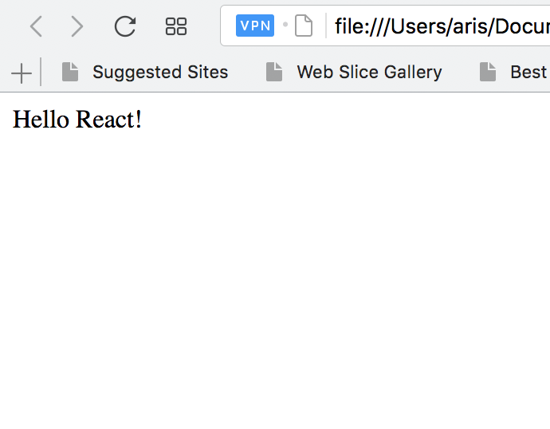
Running our project
Now the command npm run build runs Webpack in production mode, which minimizes the bundle file automatically, and
the command npm run dev runs the Webpack in the watch mode.
Open the html file on a browser to run the example

